Slide 1

Open Science and Reproducibility
Alexandra Sarafoglou
Eric-Jan Wagenmakers
@OSCAmsterdam
openscience-amsterdam.com

Slide 2
Overview
What researchers want
What the field gets
How to uncover hidden uncertainty

Slide 3
Methodology 101
There is a conceptual distinction between hypothesis-generating and hypothesis-testing research (De Groot 1956/2014; Reichenbach, 1938)
When the data inspire a hypothesis, you cannot use the same data to test this hypothesis

Slide 4
Methodology 101
Old knowledge & Old Data
New Hypothesis
New Prediction
Test on New Data
Evaluation
knowledge accumulation
speculate
& explore
deduce
statistical analysis
design
new experiment

Slide 5
Methodology 101
Old knowledge & Old Data
New Hypothesis
New Prediction
Test on New Data
Evaluation
knowledge accumulation
speculate
& explore
The Statistical Context of Justification – Confirmatory Research
The Creative Context of Discovery
–
Exploratory Research
deduce
statistical analysis
design
new experiment

Slide 6
Methodology 101
Old knowledge & Old Data
New Hypothesis
New Prediction
Test on New Data
Evaluation
knowledge accumulation
speculate
& explore
The Statistical Context of Justification – Confirmatory Research
The Creative Context of Discovery
–
Exploratory Research
fooling
yourself
deduce
statistical analysis
design
new experiment

Slide 7
Main Dilemma
Dr. X has a favorite theory that she has worked on and published about previously.
Dr. X designs an experiment to test a prediction from her theory.
Dr. X collects the data, a painstaking and costly process. Part of her career and those of her students ride on the outcome.

Slide 8
Main Dilemma
Now the data need to be analyzed.
If p < .05, the experiment is deemed a success; if p > .05, it is deemed a failure.

Slide 9
Who is, without a shadow of doubt, the most biased analyst in the entire galaxy, past, present, and future?

Slide 10
Who is, without a shadow of doubt, the most biased analyst in the entire galaxy, past, present, and future?
X

Slide 11
The first principle is that you must not fool yourself—and you are the easiest person to fool
Richard Feynman

Slide 12
Main Dilemma
So the world’s most biased analyst, Dr. X, the easiest person to fool, proceeds to analyze the data.
Dr. X can do this alone, without any oversight whatsoever. In most cases, the data and analysis code never leave the lab.

Slide 13
A Perfect Storm
Data are analyzed with no accountability, by the person who is easiest to fool, often with limited statistical training, who has every incentive imaginable to produce p < .05.
When p < .05, the result is declared “significant” and any further doubt is frowned upon, as it violates an implicit social contract.

Slide 14
What Researchers Want
To discover the truth, but also:
To present compelling data that leave no room for doubt or dissent
To develop a coherent theoretical framework
To publish papers that make interesting claims

Slide 15
What The Field Gets
Fruits of Perverse Incentives and Uncertainty-Allergy:
Publication bias
Fudging
HARKing

Slide 16
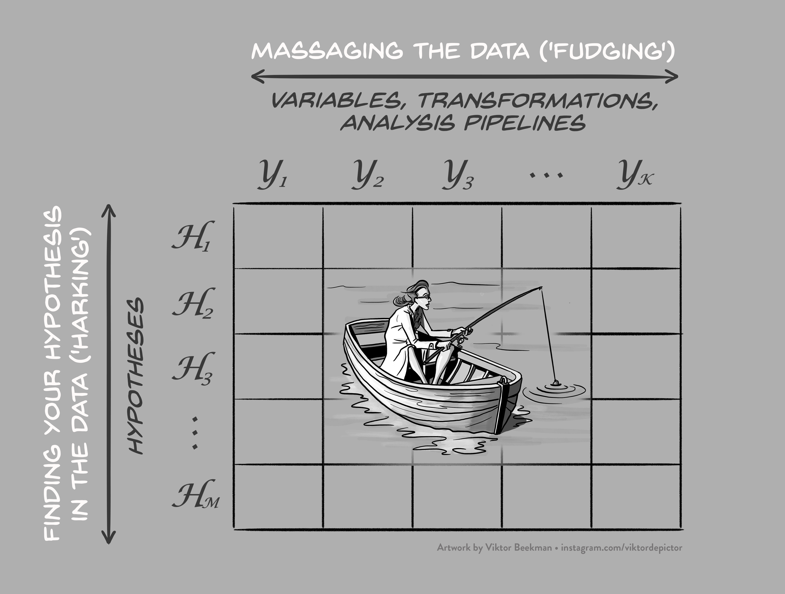

Slide 17
What The Field Gets
Simmons, Nelson, Simonsohn (2011)

Slide 18
Overconfident Claims.
Spurious Results.

Slide 19
How To Uncover Hidden Uncertainty
1
Open Science Tools

Slide 20
Method 1: Preregistration of Analysis Plans
Strict separation between exploratory and confirmatory research
Specify hypotheses and all statistical analyses before data collection

Slide 21
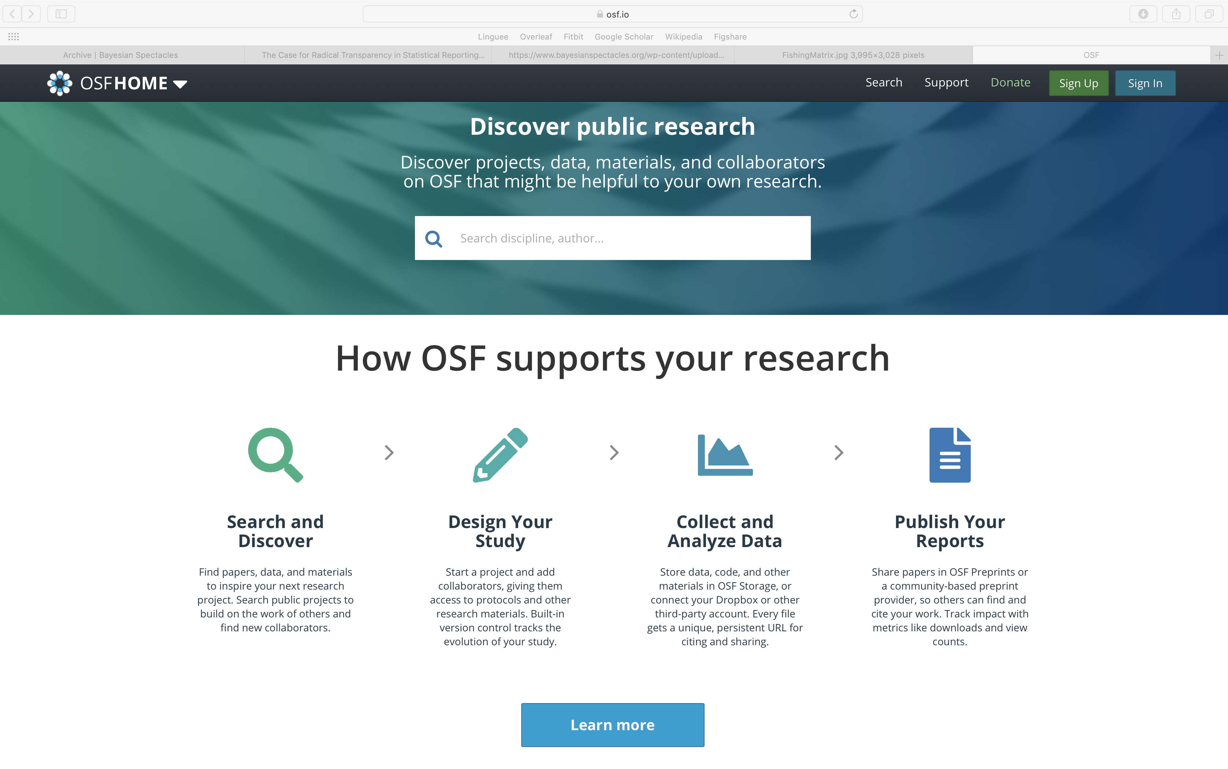
Open Science Framework (https://osf.io)
Preregistration is published with timestamp in a trusted online repository

Slide 22
Method 1: Preregistration of Analysis Plans
After data collection, the preregistered analyses are conducted in an automated fashion
Forces researchers to adhere to the empirical cycle
Does not rule out exploratory analyses; just labels them as such
Most efficient way to combat implicit and explicit forms of significance seeking

Slide 23
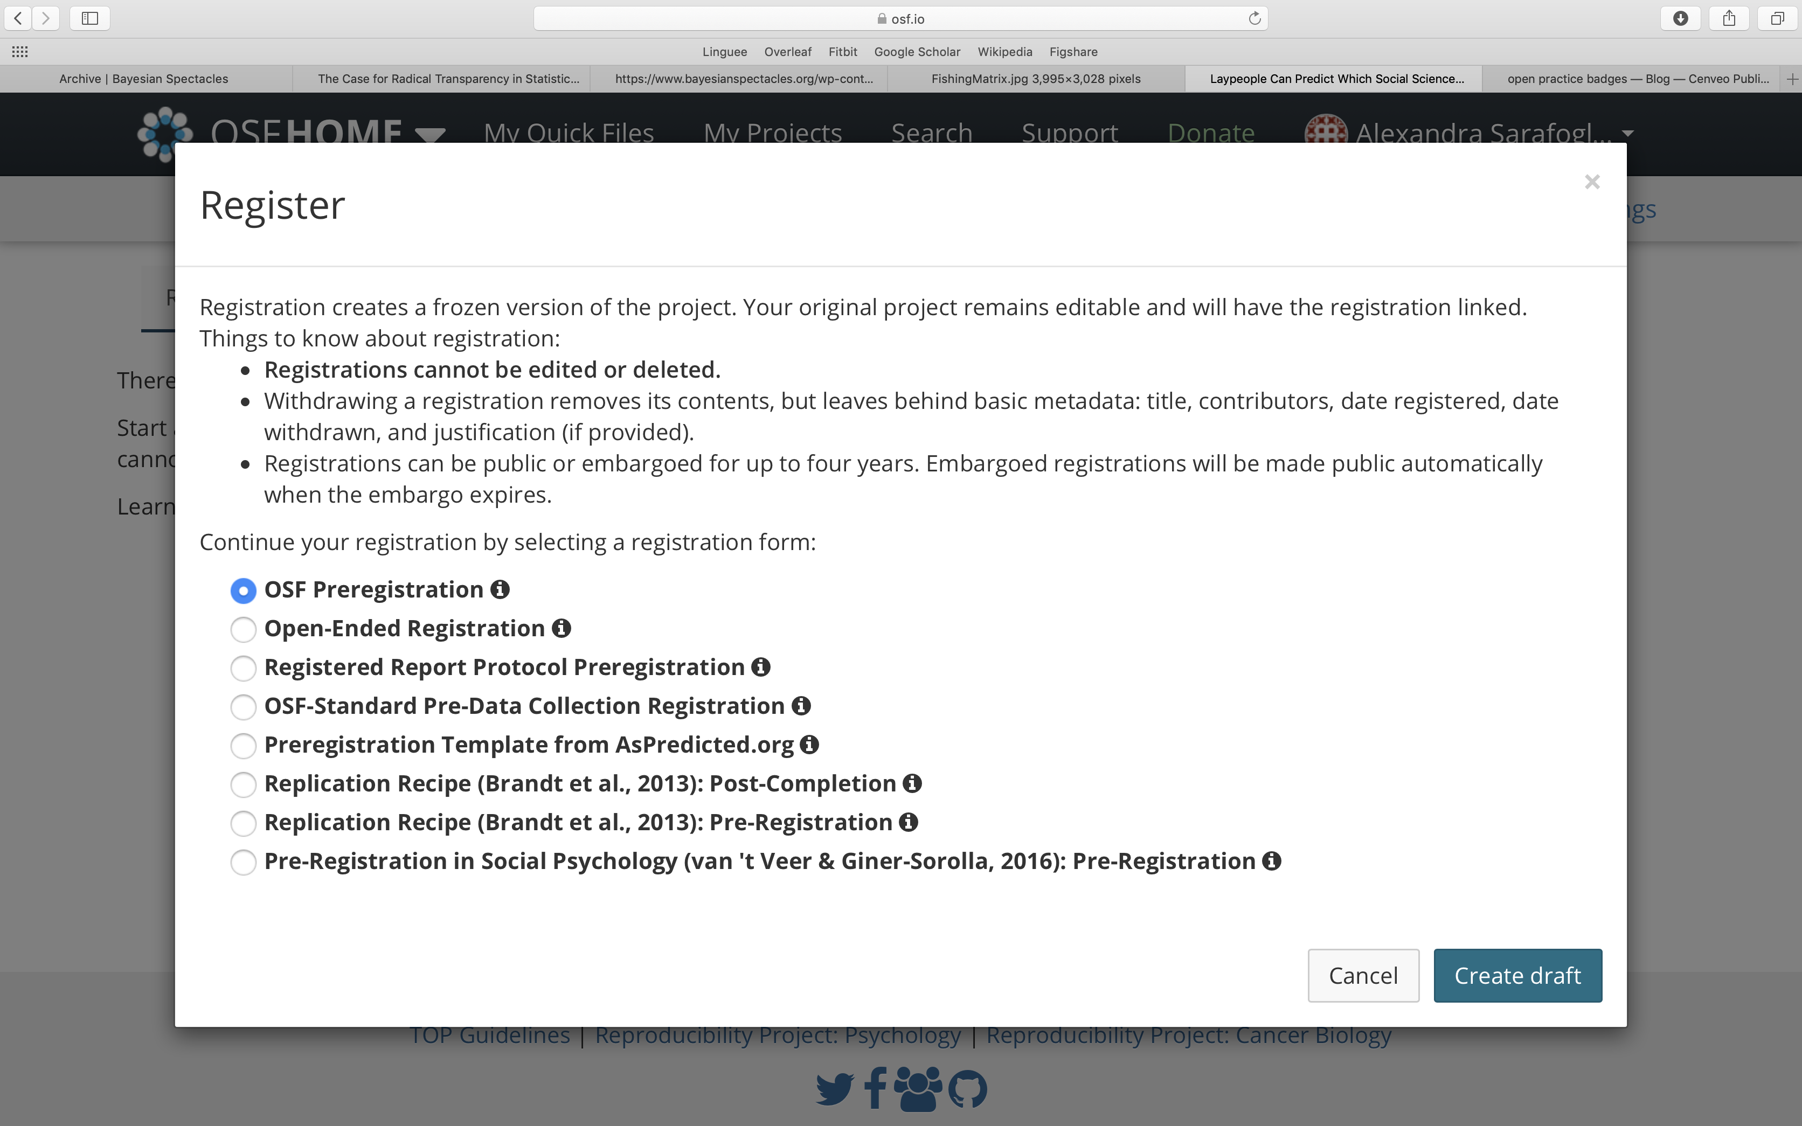
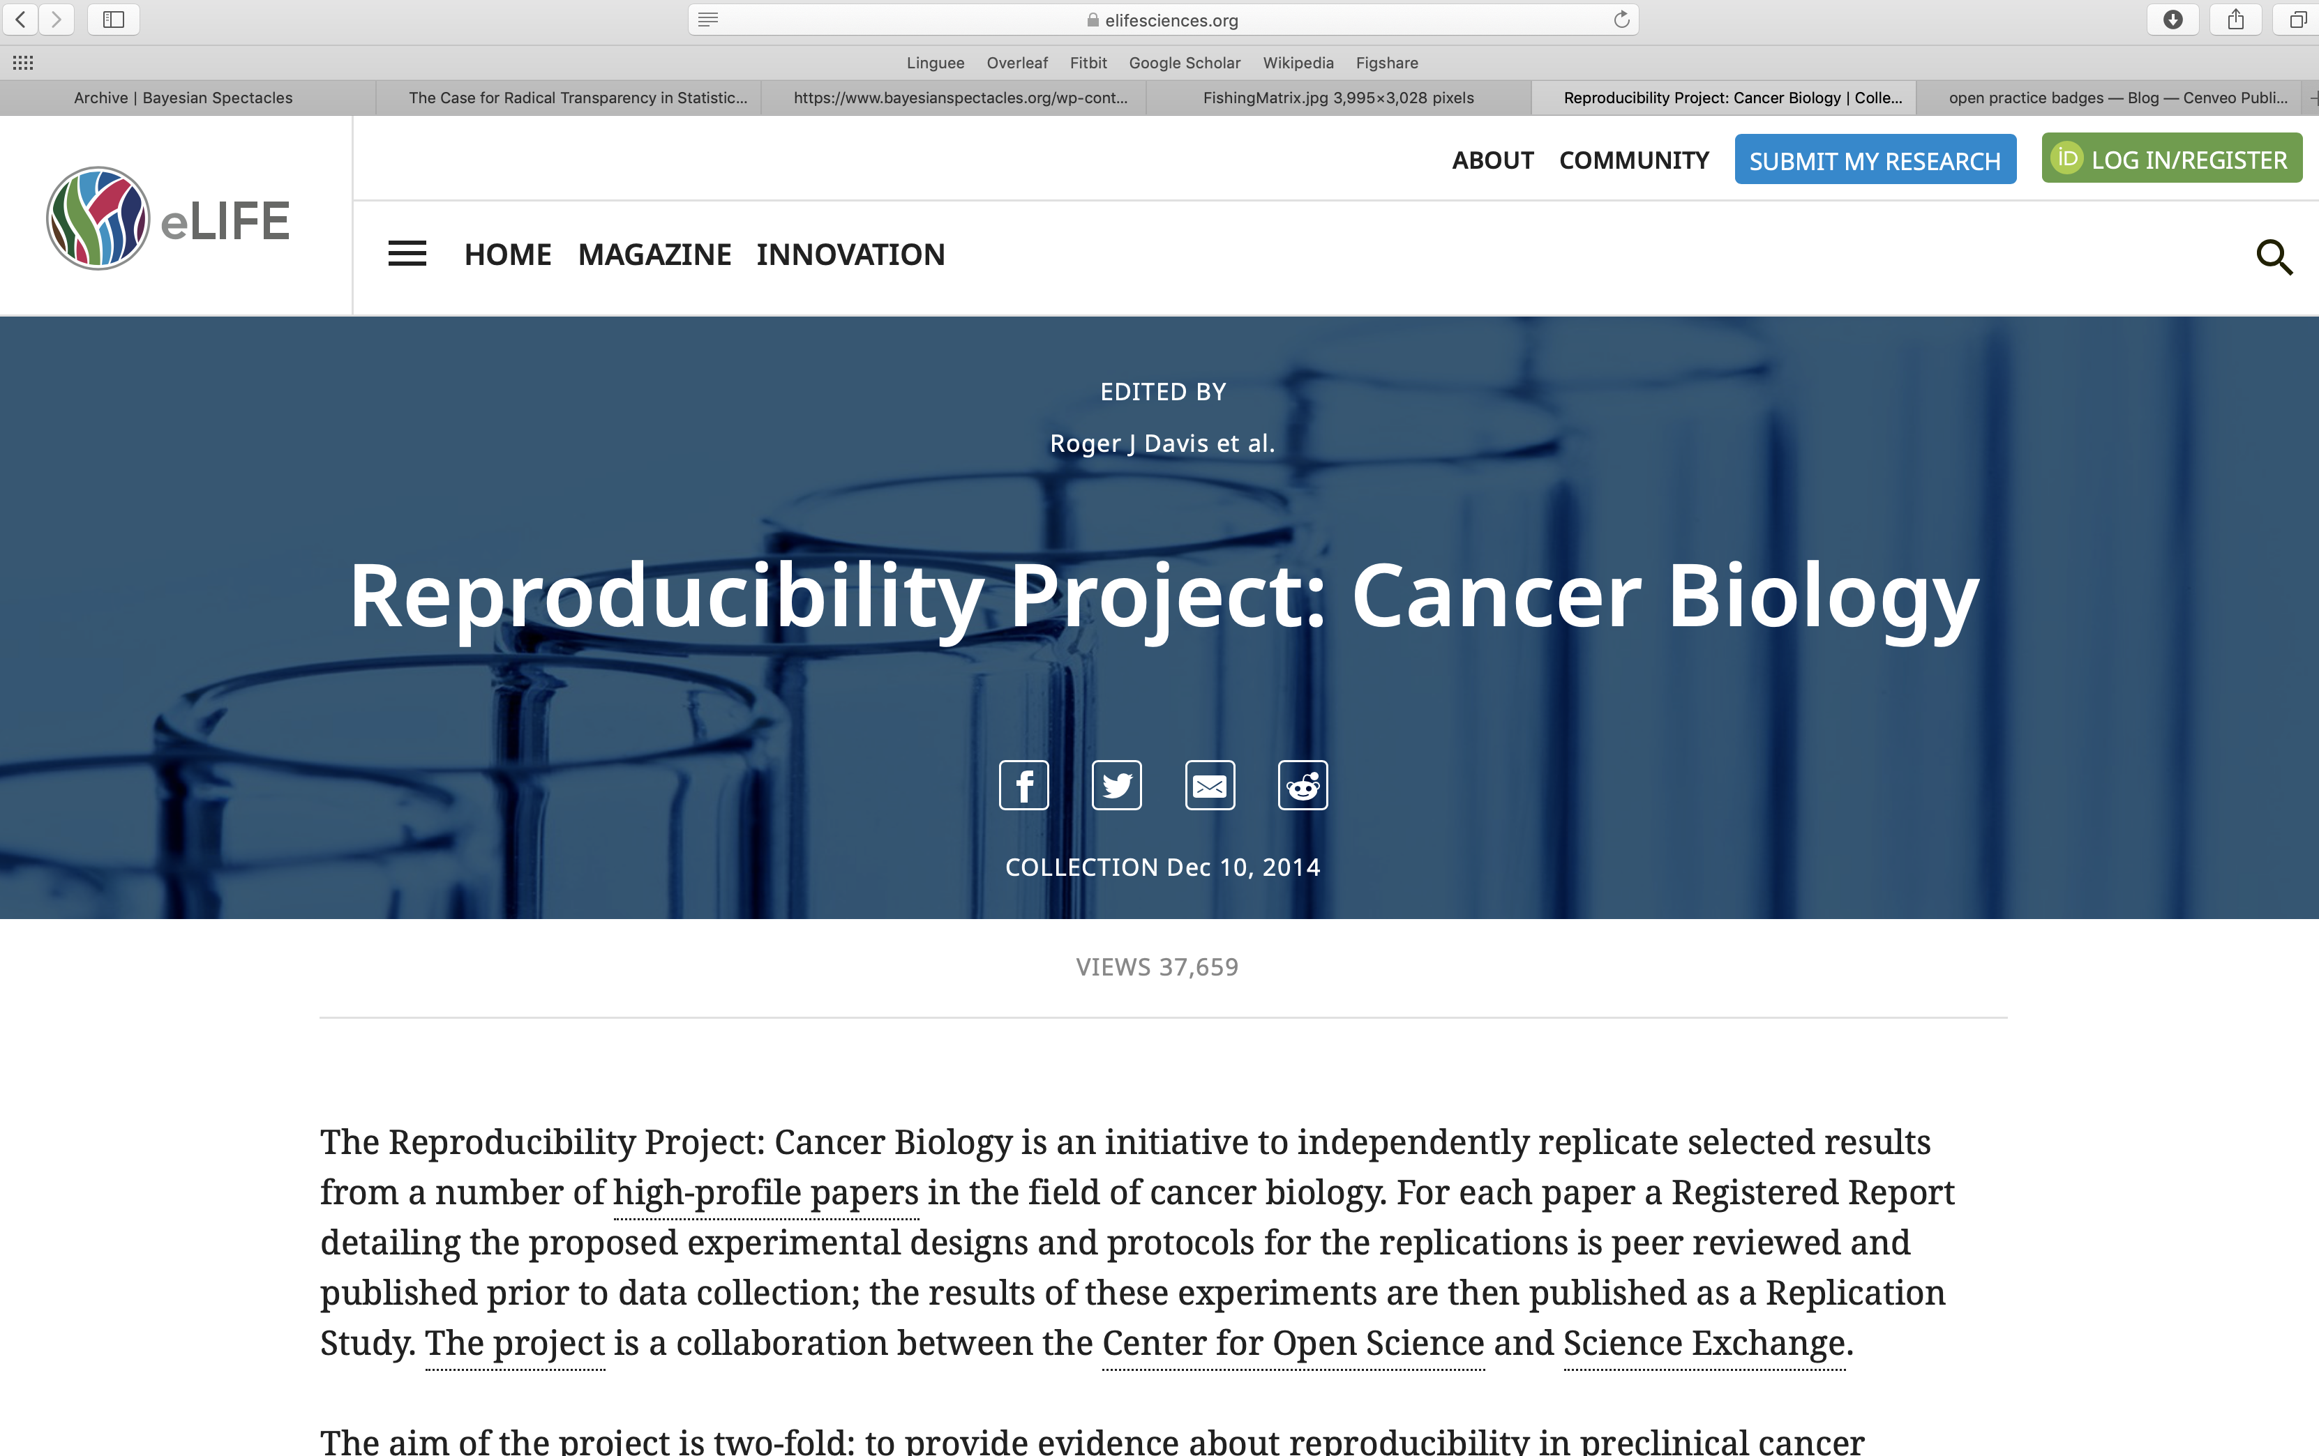
Method 1: Preregistration of Analysis Plans
Online templates
Published Preregistrations

Slide 24
How to write a good preregistration
“Are soccer referees more likely to give red cards to players with dark skin than to players with light skin?”

Slide 25
How to write a good preregistration
How to measure skin color?
Control for referees skin color?
Is each red card decision independent?
What about other ethnicities?

Slide 26
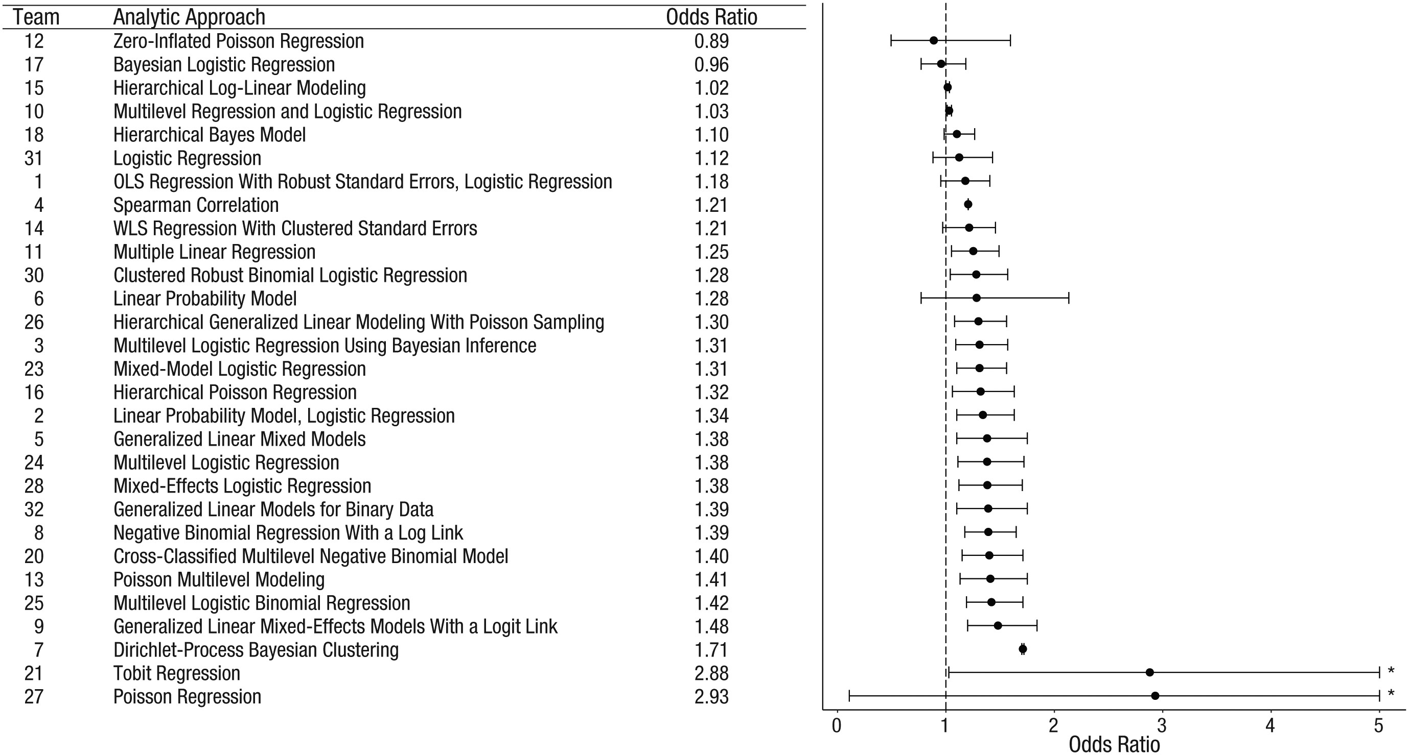

Slide 27
How to write a good preregistration
Create and Analyze Dummy Data
Simulations
Pilot Studies
Existing Data

Slide 28
Method 2: Sensitivity Analyses
Examine sensitivity to modeling choices:
Multiverse analysis
Crowd sourcing
Ideally this is done by independent labs

Slide 29
Method 3: Blinded Analyses
Challenges of Preregistration: Unexpected features of the data
Dutilh et al. (2017): Preregistration of an impossible analysis
Reproducibility Project: Cancer Biology
Horrigan (2017): Spontaneous tumor regressions
Arid, Kandela & Mantis (2017): Unexpected early deaths in control group

Slide 30
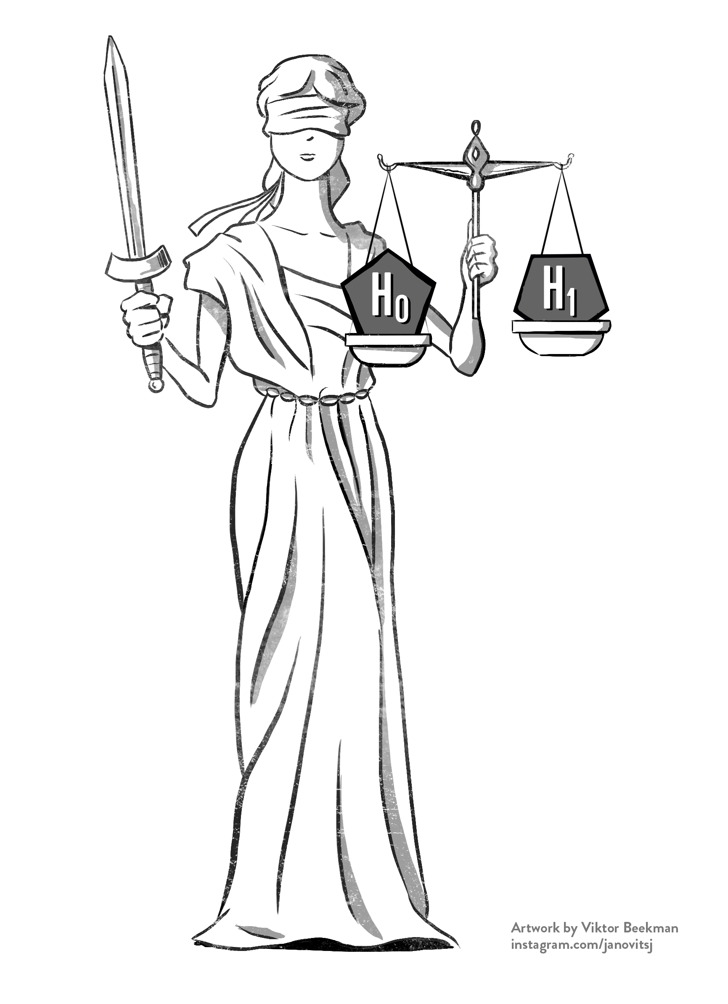
Method 3: Blinded Analyses
Common Practice in (Astro-) physics
Allows researchers to make data depend choices without introducing bias

Slide 31
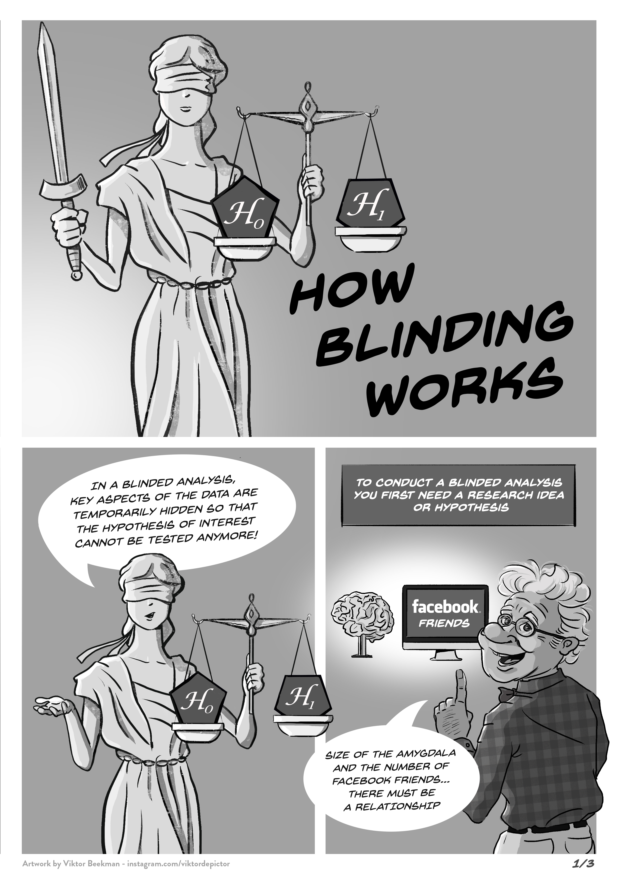
How Blinding Works

Slide 33
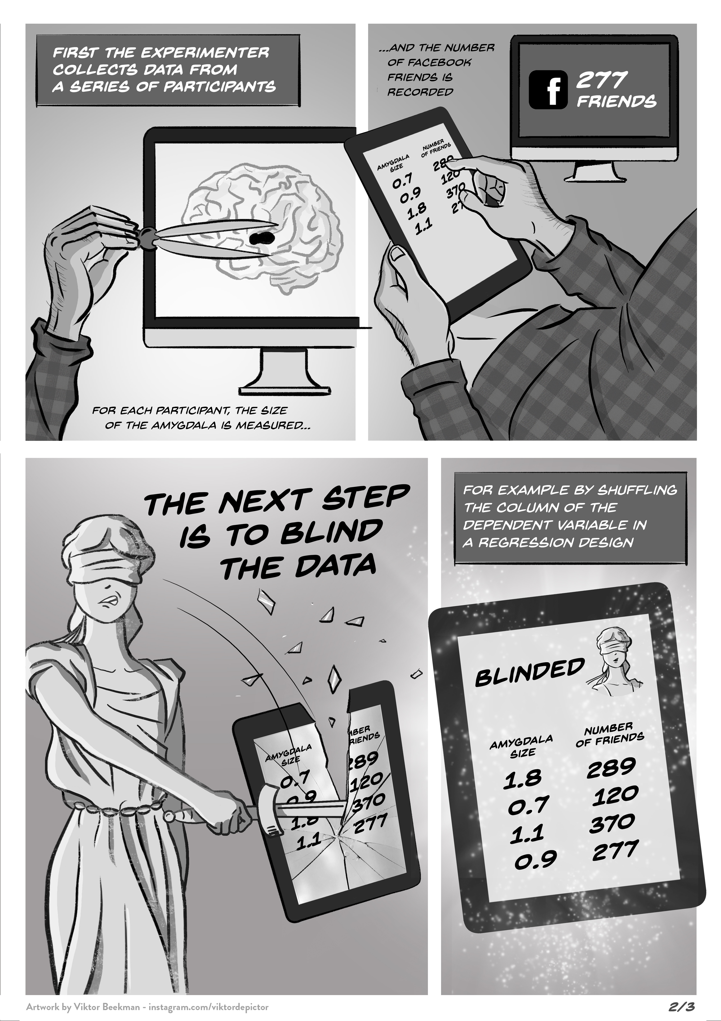

Slide 35
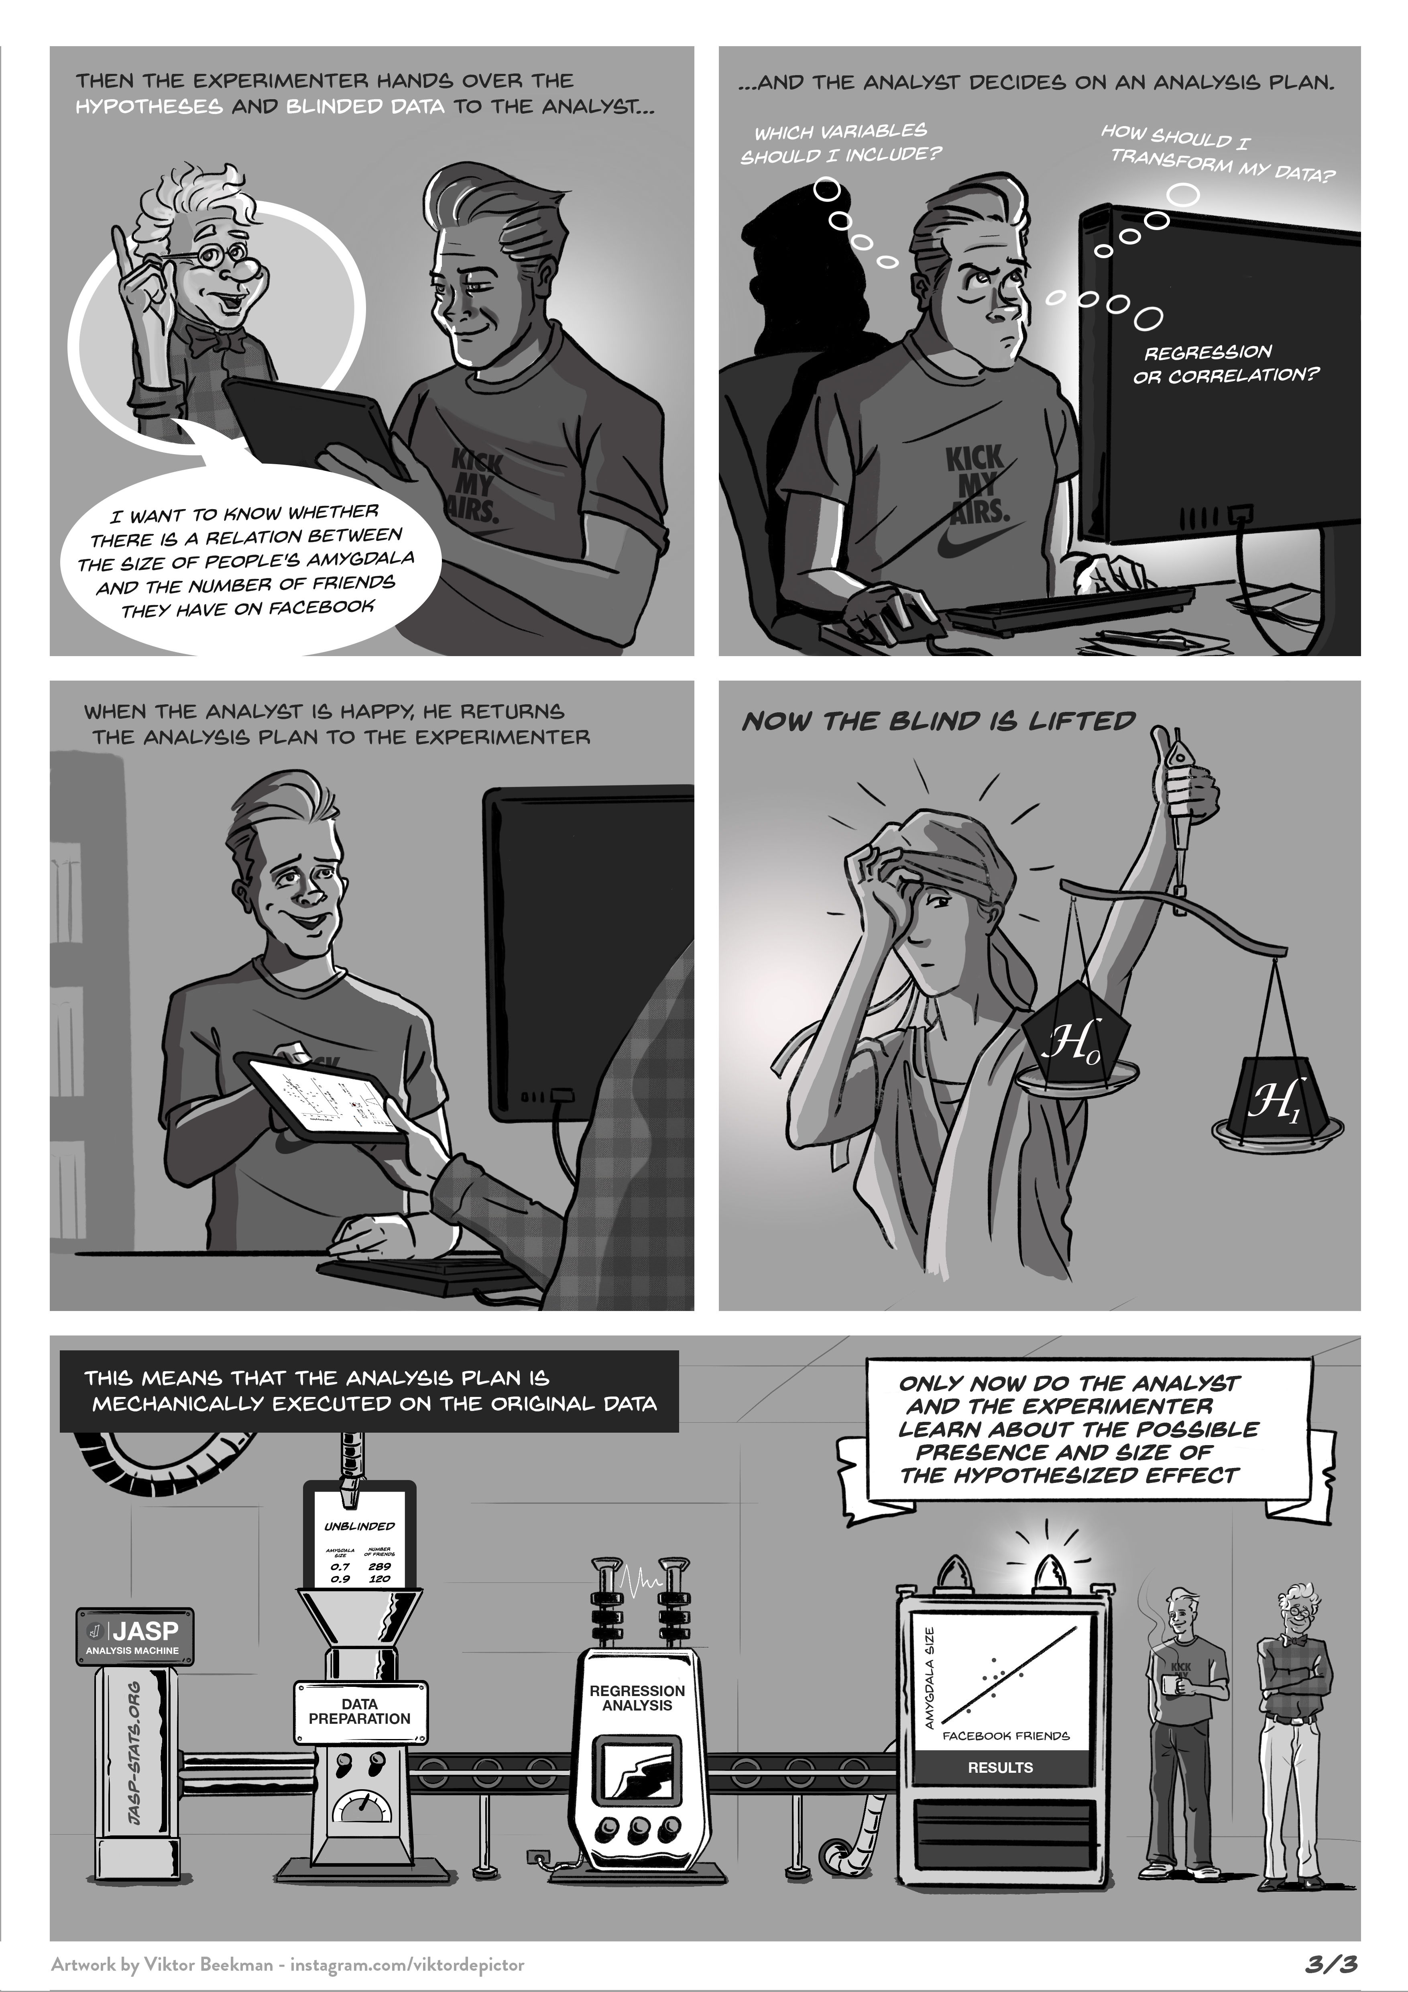

Slide 38
# Facebook Friends | Amygdala Size | Gender | Age | Overal Brain volume
190 | 0.655 | male | 28 | 1238
232 | 0.680 | male | 35 | 1386
84 | 0.647 | female | 18 | 1176
311 | 0.698 | male | 20 | 1172
138 | 0.699 | female | 27 | 1185
356 | 0.732 | female | 34 | 970
Blind Data by Shuffling Rows (Regression Designs or Correlational Data)

Slide 39
# Facebook Friends | Amygdala Size | Gender | Age | Overall Brain volume
84 | 0.655 | male | 28 | 1238
356 | 0.680 | male | 35 | 1386
190 | 0.647 | female | 18 | 1176
232 | 0.698 | male | 20 | 1172
138 | 0.699 | female | 27 | 1185
311 | 0.732 | female | 34 | 970
Blind Data by Shuffling Rows (Regression Designs or Correlational Data)

Slide 40
Gender
 | male | female
high | 13.7 (SD 1) | 14.5 (SD 1.2)
low | 11.8 (SD 2) | 9.46 (SD 2.5)
Education
Blind Data by Hiding the Labels (ANOVA Designs)

Slide 41
Gender
 | ? | ?
? | 13.7 (SD 1) | 14.5 (SD 1.2)
? | 11.8 (SD 2) | 9.46 (SD 2.5)
Education
Blind Data by Hiding the Labels (ANOVA Designs)

Slide 42
Method 4: Share the Data
Facilitates re-analysis, verification, and meta-analysis
In review process, allows reviewers to propose and carry out informative alternative analyses

Slide 43
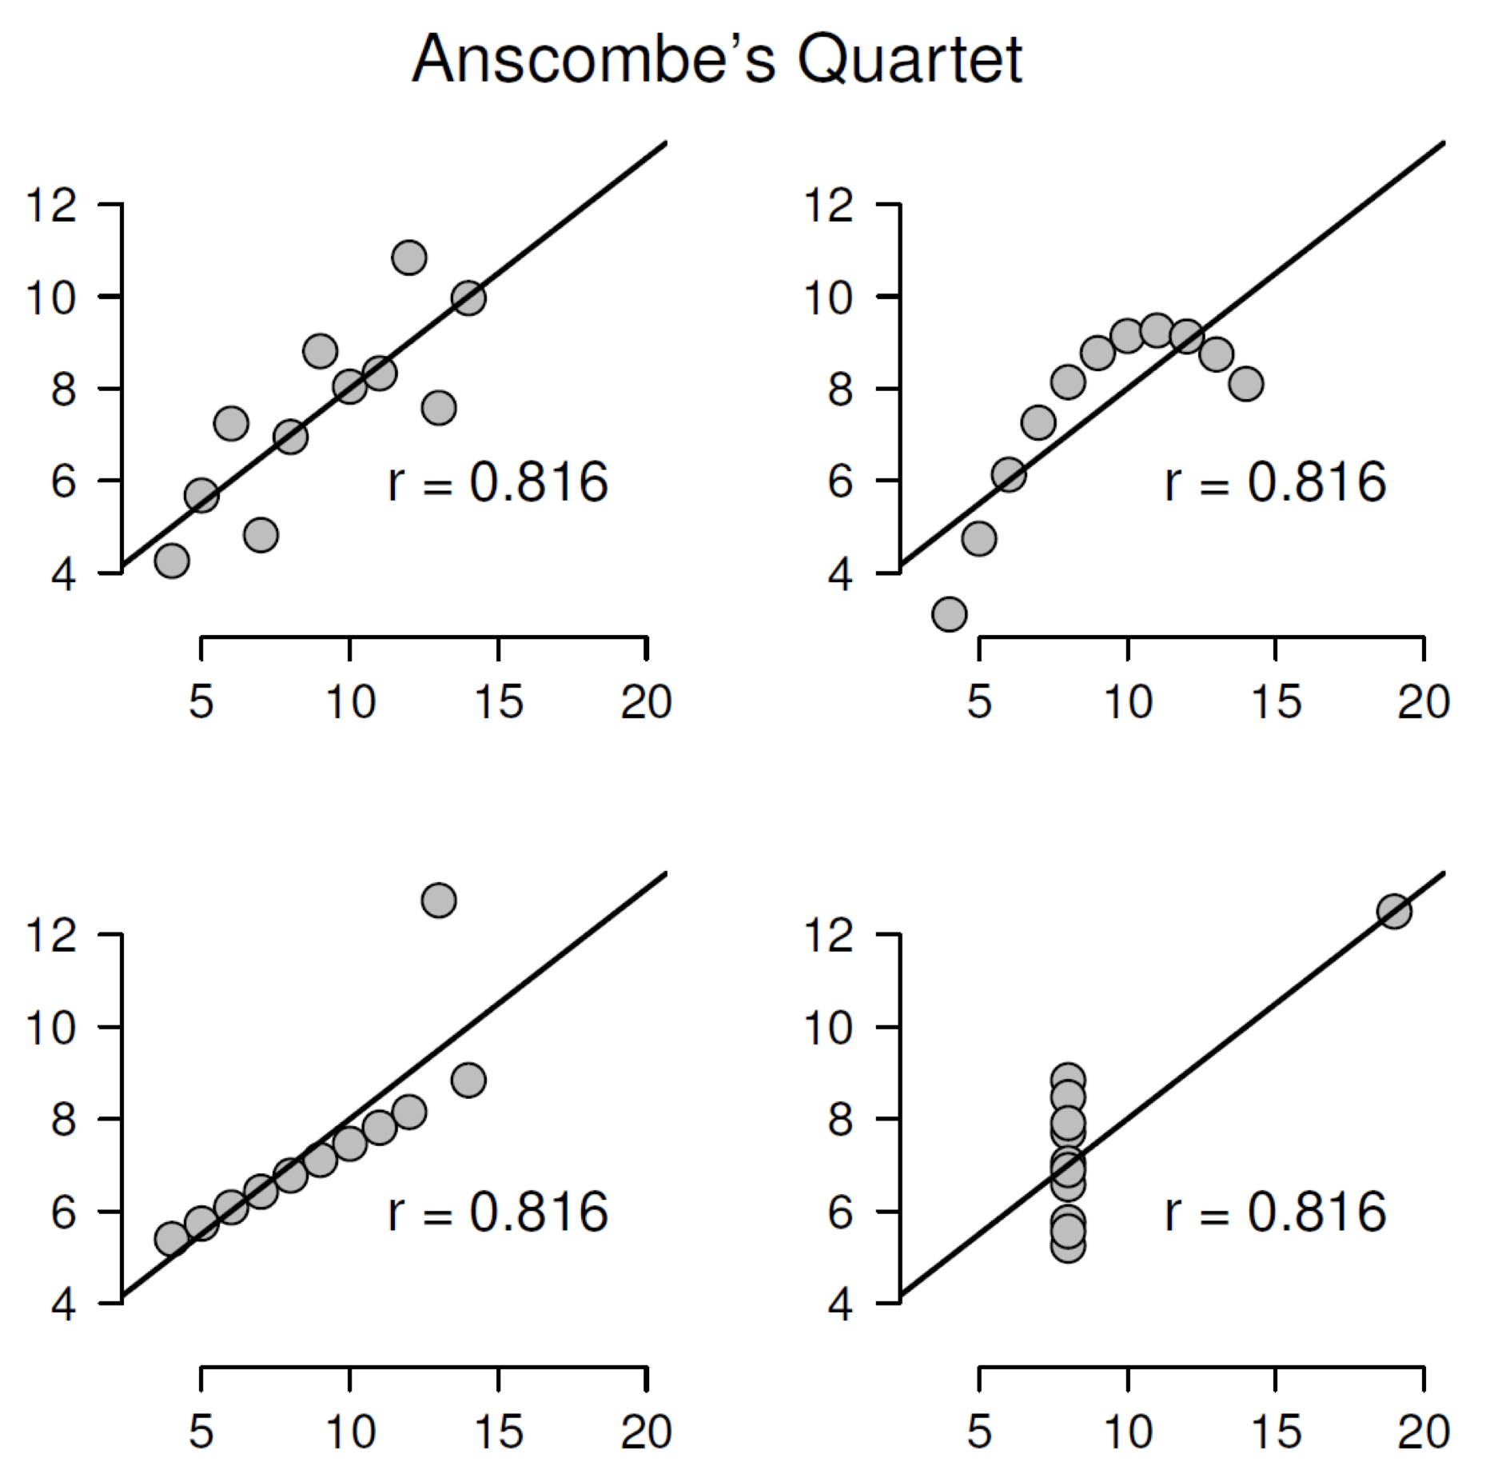
Method 4: Share the Data
Plot your data!

Slide 44

Method 5: Share Experiences
@OSCAmsterdam
openscience-amsterdam.com

Slide 45
Concluding Comments
More transparency is needed
Transparency means mental hygiene: the scientific equivalent of brushing your teeth, or washing your hands after visiting the restroom
This requires a change in culture

Slide 46
Concluding Comments
Journals and funders starting to demand mental hygiene
Mental hygiene can also be rewarded. For instance, journals could prefer to publish preregistered studies, or studies that share their data, materials, and code

Slide 47
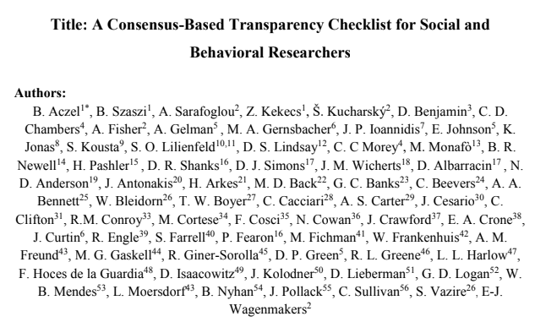
Concluding Comments
Social and Behavioral Sciences
Transparency Checklist
https://eltedecisionlab.shinyapps.io/TransparencyChecklist/

Slide 48
Concluding Comments
Student projects are ideal to try out and learn about Open Science Practices!

Slide 49
References
Slides were (mostly) created by Eric-Jan Wagenmakers
https://www.bayesianspectacles.org/wp-content/uploads/2018/01/RadicalTransparency.pdf
https://www.youtube.com/watch?v=LxRHkk2MBWw&t=35s
False-Positive Psychology
Simmons, J. P., Nelson, L. D., & Simonsohn, U. (2011). False-positive psychology: Undisclosed flexibility in data collection and analysis allows presenting anything as significant. Psychological science, 22(11), 1359-1366.
Many Analyst Study
Silberzahn, R., Uhlmann, E. L., Martin, D. P., Anselmi, P., Aust, F., Awtrey, E., ... & Carlsson, R. (2018). Many analysts, one data set: Making transparent how variations in analytic choices affect results. Advances in Methods and Practices in Psychological Science, 1(3), 337-356.
Literature on Sensitivity Analyses
Steegen, S., Tuerlinckx, F., Gelman, A., & Vanpaemel, W. (2016). Increasing transparency through a multiverse analysis. Perspectives on Psychological Science, 11(5), 702-712.
Literature on Blinding
MacCoun, R., & Perlmutter, S. (2015). Blind analysis: hide results to seek the truth. Nature News, 526(7572), 187.
Dutilh, G., Sarafoglou, A., & Wagenmakers, E.-J. (in press). Flexible yet fair: Blinding analyses in experimental psychology. Synthese. Preprint available on PsyArXiv: https://psyarxiv.com/d79r8

